Slide 1


The Mechanics of Sight: Capturing Digital Reality
How light → sensor → digital image. Visual story of capture from scene to file.
Presented By:
K . Pavan Deekshith
192412172
ITA0502-Computer Vision

Slide 2


Fundamentals of Image Acquisition
Illumination interacts with surfaces: reflection, absorption, scattering
Sensor converts electromagnetic energy → electrical signal
2D sensor arrays capture whole scene in one exposure (vs line-scan)
Keep exposure, spectrum, and geometry consistent for accurate capture

Slide 3
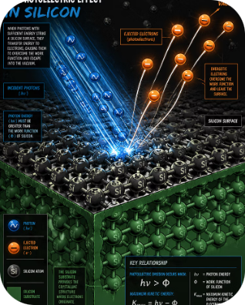
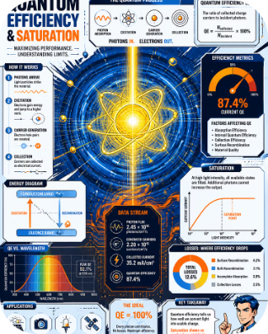

The Sensor: Converting Light to Data
Photosites
Photoelectric Effect
Key Metrics
Photon buckets store electrons during exposure — charge ∝ light intensity
Photons liberate electrons → measurable charge
Quantum Efficiency (QE), Full‑well capacity, Noise floor
Design trade-offs: QE vs pixel size; well capacity vs dynamic range.

Slide 4
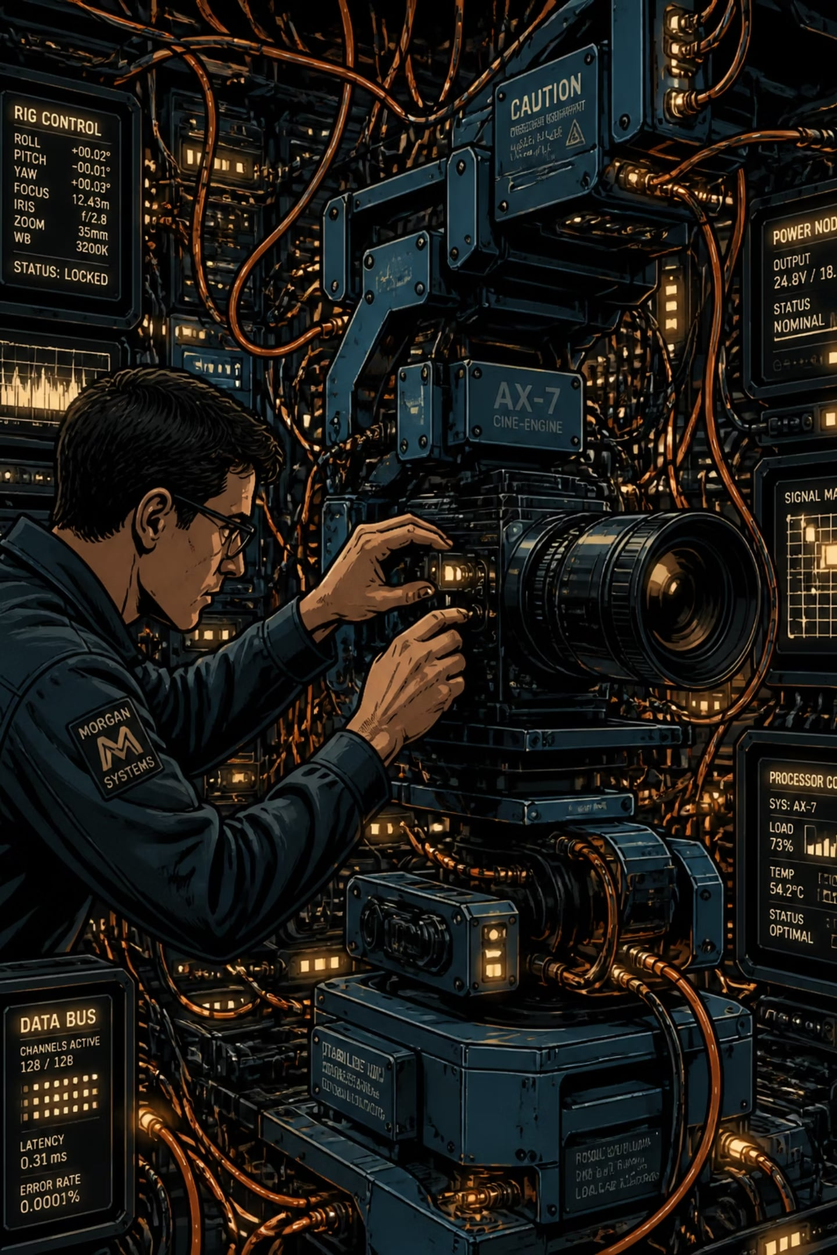
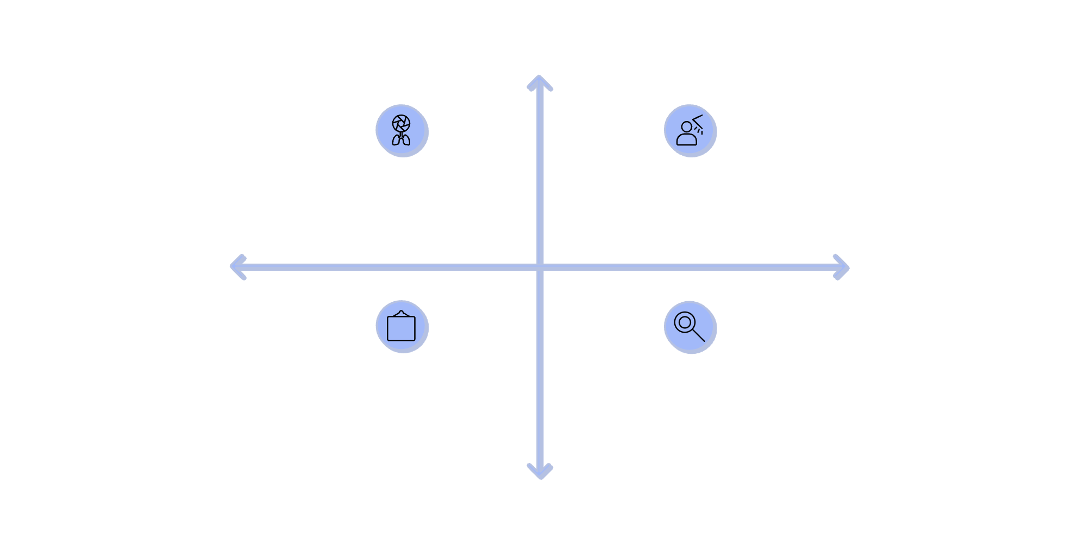
Real-World Challenges
High Light Quality
Aperture: Diffraction vs Depth
Exposure: Noise vs Clipping
Low Throughput
High Throughput
Frame Rate: Bandwidth Limits
Optics: Aberrations vs Correction
Low Light Quality
Aperture trade-off: small aperture → diffraction blur; large → shallow depth and lighter. - Exposure trade-off: low exposure → sensor/thermal noise; high → clipping highlights. - Throughput: high frame rates demand huge bandwidth and low-latency processing.

Slide 5
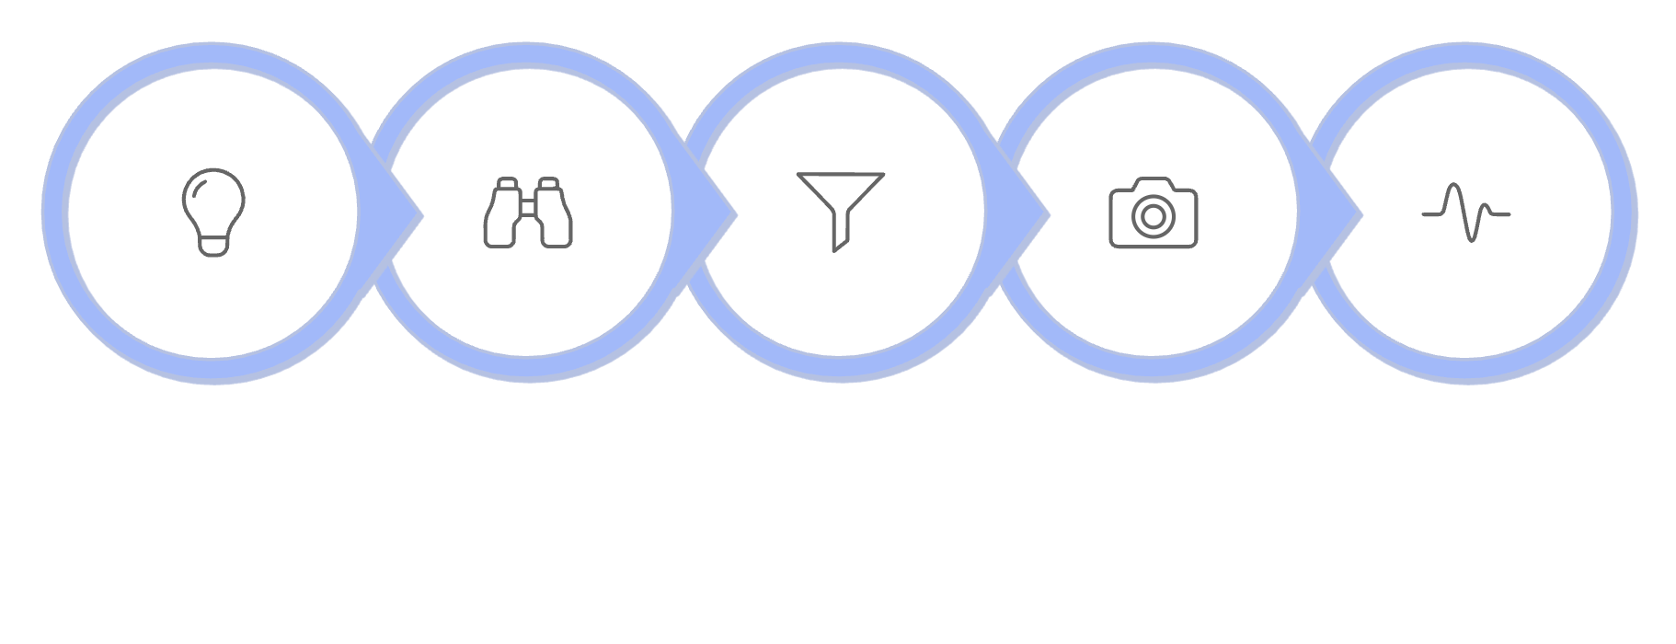

Signal → Representation: Pipeline & System Model
Optics
Sensor & Analog
Image formation, aberrations, focus
QE, well capacity, noise, CDS
Digital
Processing
Illumination
Optics
Colour Filter
Sensor
Analog
ADC, demosaic, compression
Tone, colour, reconstruction
Next steps: choose sensors and optics to balance light, noise, bandwidth, and final representation goals.
Optimise each block for target fidelity: resolution, dynamic range, temporal performance

